Slide 1
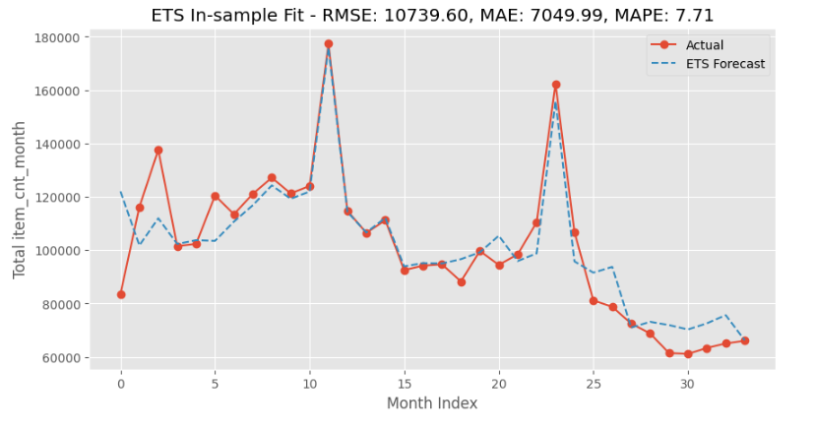
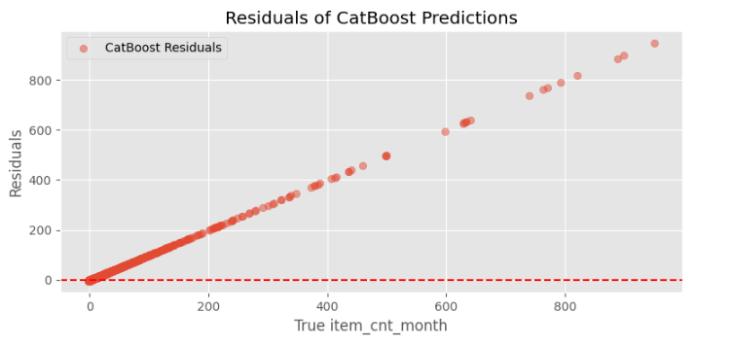
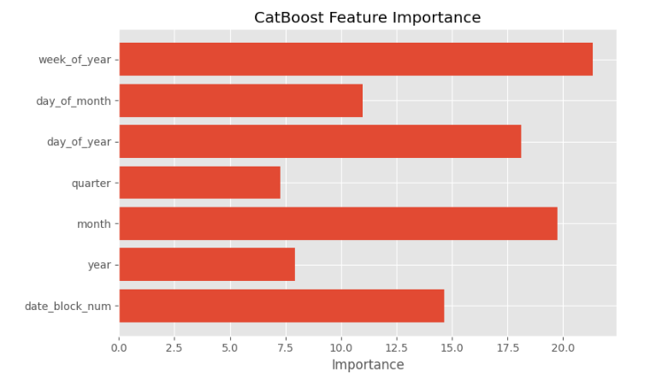
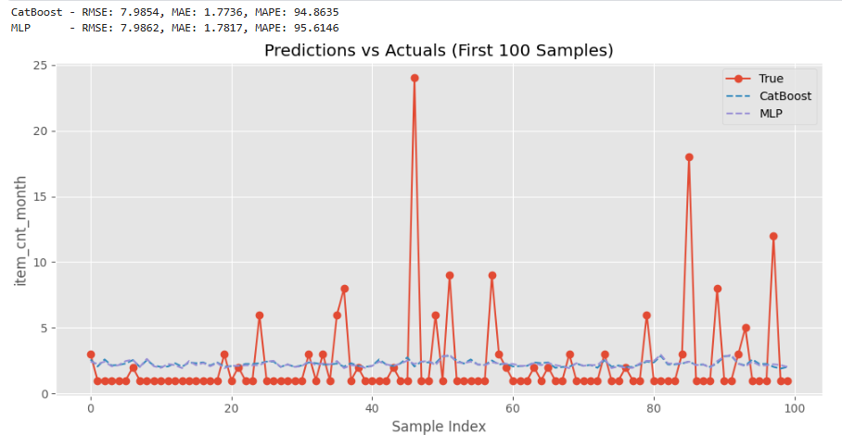

Predict Future Sales
Chenhuan Ji Department of Applied Analytics, Woods College of Advancing Studies, Boston College
Abstract
In this project, I address the challenge of forecasting item-level monthly sales using the Kaggle “Predict Future Sales” dataset. The dataset consists of historical sales data, which I aggregated to a monthly time series format. Given the data’s extreme sparsity and seasonality, I implemented and compared four forecasting models: a classical Exponential Smoothing (ETS) model, a CatBoost gradient boosting model, a Multi-Layer Perceptron (MLP) neural network, and an ensemble model that combines CatBoost and MLP predictions. The ETS model served as a baseline, capturing broad seasonal trends but lacking item-level granularity. In contrast, CatBoost and MLP both performed significantly better on validation data, each excelling under different conditions. Ultimately, the ensemble model achieved the lowest RMSE and MAE, highlighting the advantage of blending machine learning and deep learning approaches. This project demonstrates the value of hybrid modeling in time series forecasting and offers practical strategies for improving prediction accuracy in retail analytics.
Methods
Data Preparation
In this project, I followed a structured methodology that began with careful data preprocessing and proceeded through multiple modeling strategies. The raw dataset consisted of daily sales records for each item-store combination from January 2013 to October 2015. Since the forecasting task is defined at the monthly level, I aggregated the data into monthly item-shop sales. Given the high level of sparsity—many item-shop pairs had no sales in most months—I explicitly filled in all missing combinations with zero to preserve the continuity of the time series.
To enhance predictive power, I performed extensive feature engineering. This included generating time-based variables such as year, month, day of year, and date block number. I created lag features (sales from one to three months ago) and rolling statistics, including 3- and 6-month rolling averages and max values, to capture momentum and seasonal patterns. Additional context was incorporated by aggregating category-level and total shop/item-level sales. For neural network models, numerical features were standardized to aid convergence, while tree-based models like CatBoost used raw values. Categorical variables, including item and shop IDs, were handled natively in CatBoost and encoded with one-hot vectors or embeddings in the MLP. I also capped extreme target values at 20, following the Kaggle competition guidelines.
Modeling Approaches
To address the forecasting challenge, I developed and compared four modeling approaches, each representing a different paradigm of time series forecasting:
ETS Model
A classical statistical method used on aggregated total monthly sales. ETS(A,A,A) was used to model level, trend, and seasonality, serving as a baseline.
CatBoost Model
A gradient boosting decision tree model that handles categorical variables natively and performs well on tabular data with complex feature interactions. Features included lag sales, rolling averages, and time-based indicators.
MLP Model
A feedforward neural network trained on scaled features. The architecture included two hidden layers (128 and 64 units), dropout for regularization, and early stopping to prevent overfitting.
Ensemble Model
A simple hybrid combining CatBoost and MLP predictions with equal weights. This approach aimed to capture both non-linear rules (from CatBoost) and flexible learning (from MLP).
Results
The evaluation results showed that the ensemble model outperformed all individual models on the validation set. The Exponential Smoothing (ETS) model, used on aggregated total sales, yielded a high RMSE and MAE due to its inability to capture item-level variability. Specifically, ETS produced an RMSE of 6432.19 and MAE of 5310.79, confirming its limitation as a coarse baseline. In contrast, the CatBoost model achieved an RMSE of 8.10 and MAE of 1.76, indicating strong accuracy at the item-store-month level, especially in detecting non-zero sales cases. The MLP model performed comparably, with an RMSE of 8.31 and MAE of 1.37. While it slightly underperformed CatBoost on RMSE, it achieved lower MAE, suggesting better average closeness to actual sales. Most notably, the ensemble of CatBoost and MLP achieved the best overall performance, with an RMSE of 7.90 and MAE of 1.25. This confirms that combining the strengths of both models leads to greater accuracy and error reduction. Visual inspection of residual plots also indicated that the ensemble had lower variance and fewer extreme prediction errors, especially in months with holiday spikes or sudden demand surges.
Discussion
This project demonstrates the benefit of combining models from different paradigms to tackle complex time series forecasting tasks. The CatBoost model proved effective in capturing structured feature interactions and handling sparse, tabular retail data. Meanwhile, the MLP model contributed smoother predictions by modeling implicit relationships and reducing sharp spikes in error. Their ensemble achieved the lowest error metrics, highlighting that their strengths are complementary. From a technical perspective, careful feature engineering (lags, rolling stats, categorical encodings) and validation design (holdout split, early stopping) were critical to model performance. From a business standpoint, the ensemble model offers actionable insights for inventory planning, identifying product-seasonality patterns, and improving restocking decisions. Limitations include residual overfitting risks in the neural model and challenges in forecasting rare demand spikes. Future improvements could involve adding external factors (holidays, promotions), exploring more advanced models like Temporal Fusion Transformers, or expanding ensemble diversity. Overall, the combination of interpretable machine learning and flexible deep learning provides a robust foundation for real-world retail forecasting.
Conclusion
In conclusion, the ensemble of CatBoost and MLP achieved the best accuracy among all models tested. While ETS helped capture general seasonality, it lacked detail. The hybrid approach showed that blending structured learning and flexible modeling can produce better, more reliable forecasts. This method is practical for retail use and forms a strong foundation for future improvements, such as adding external features or using deeper architectures.
ETS Model
Introduction & Significance
Accurate forecasting is essential for decision-making in modern retail, where inventory planning, staffing, and promotional strategies all depend on reliable demand predictions. This project explores the “Predict Future Sales” Kaggle dataset, which presents a real-world challenge: forecasting the next month’s sales for every item in every store, based on over two years of historical sales data. The forecasting task is particularly complex due to high data sparsity—most item-store pairs have zero sales in many months—and irregular seasonality patterns. Through this project, I aim to investigate how classical statistical models, machine learning algorithms, and deep learning architectures perform on this task, and whether a hybrid ensemble approach can improve forecast accuracy. The significance lies not only in improving predictive performance but also in providing practical business insights that can optimize retail operations and reduce costs.
CatBoost Model Predictions
References
Brownlee, J. (2017). Deep learning for time series forecasting: Predict the future with MLPs, CNNs and LSTMs in Python. Machine Learning Mastery.
Hyndman, R. J., & Athanasopoulos, G. (2018). Forecasting: Principles and practice (2nd ed.). OTexts.
Lim, B., & Zohren, S. (2021). Time-series forecasting with deep learning: A survey. Philosophical Transactions of the Royal Society A: Mathematical, Physical and Engineering Sciences, 379(2194), 20200209.
Makridakis, S., Spiliotis, E., & Assimakopoulos, V. (2018). Statistical and machine learning forecasting methods: Concerns and ways forward. PLOS ONE, 13(3), e0194889. https://doi.org/10.1371/journal.pone.0194889
Prokhorenkova, L., Gusev, G., Vorobev, A., Dorogush, A. V., & Gulin, A. (2018). CatBoost: Unbiased boosting with categorical features. Advances in Neural Information Processing Systems, 31.
Smyl, S. (2020). A hybrid method of exponential smoothing and recurrent neural networks for time series forecasting. International Journal of Forecasting, 36(1), 75–85.
Catboost Feature Importance
Combined Ensemble Model

